Slide 1
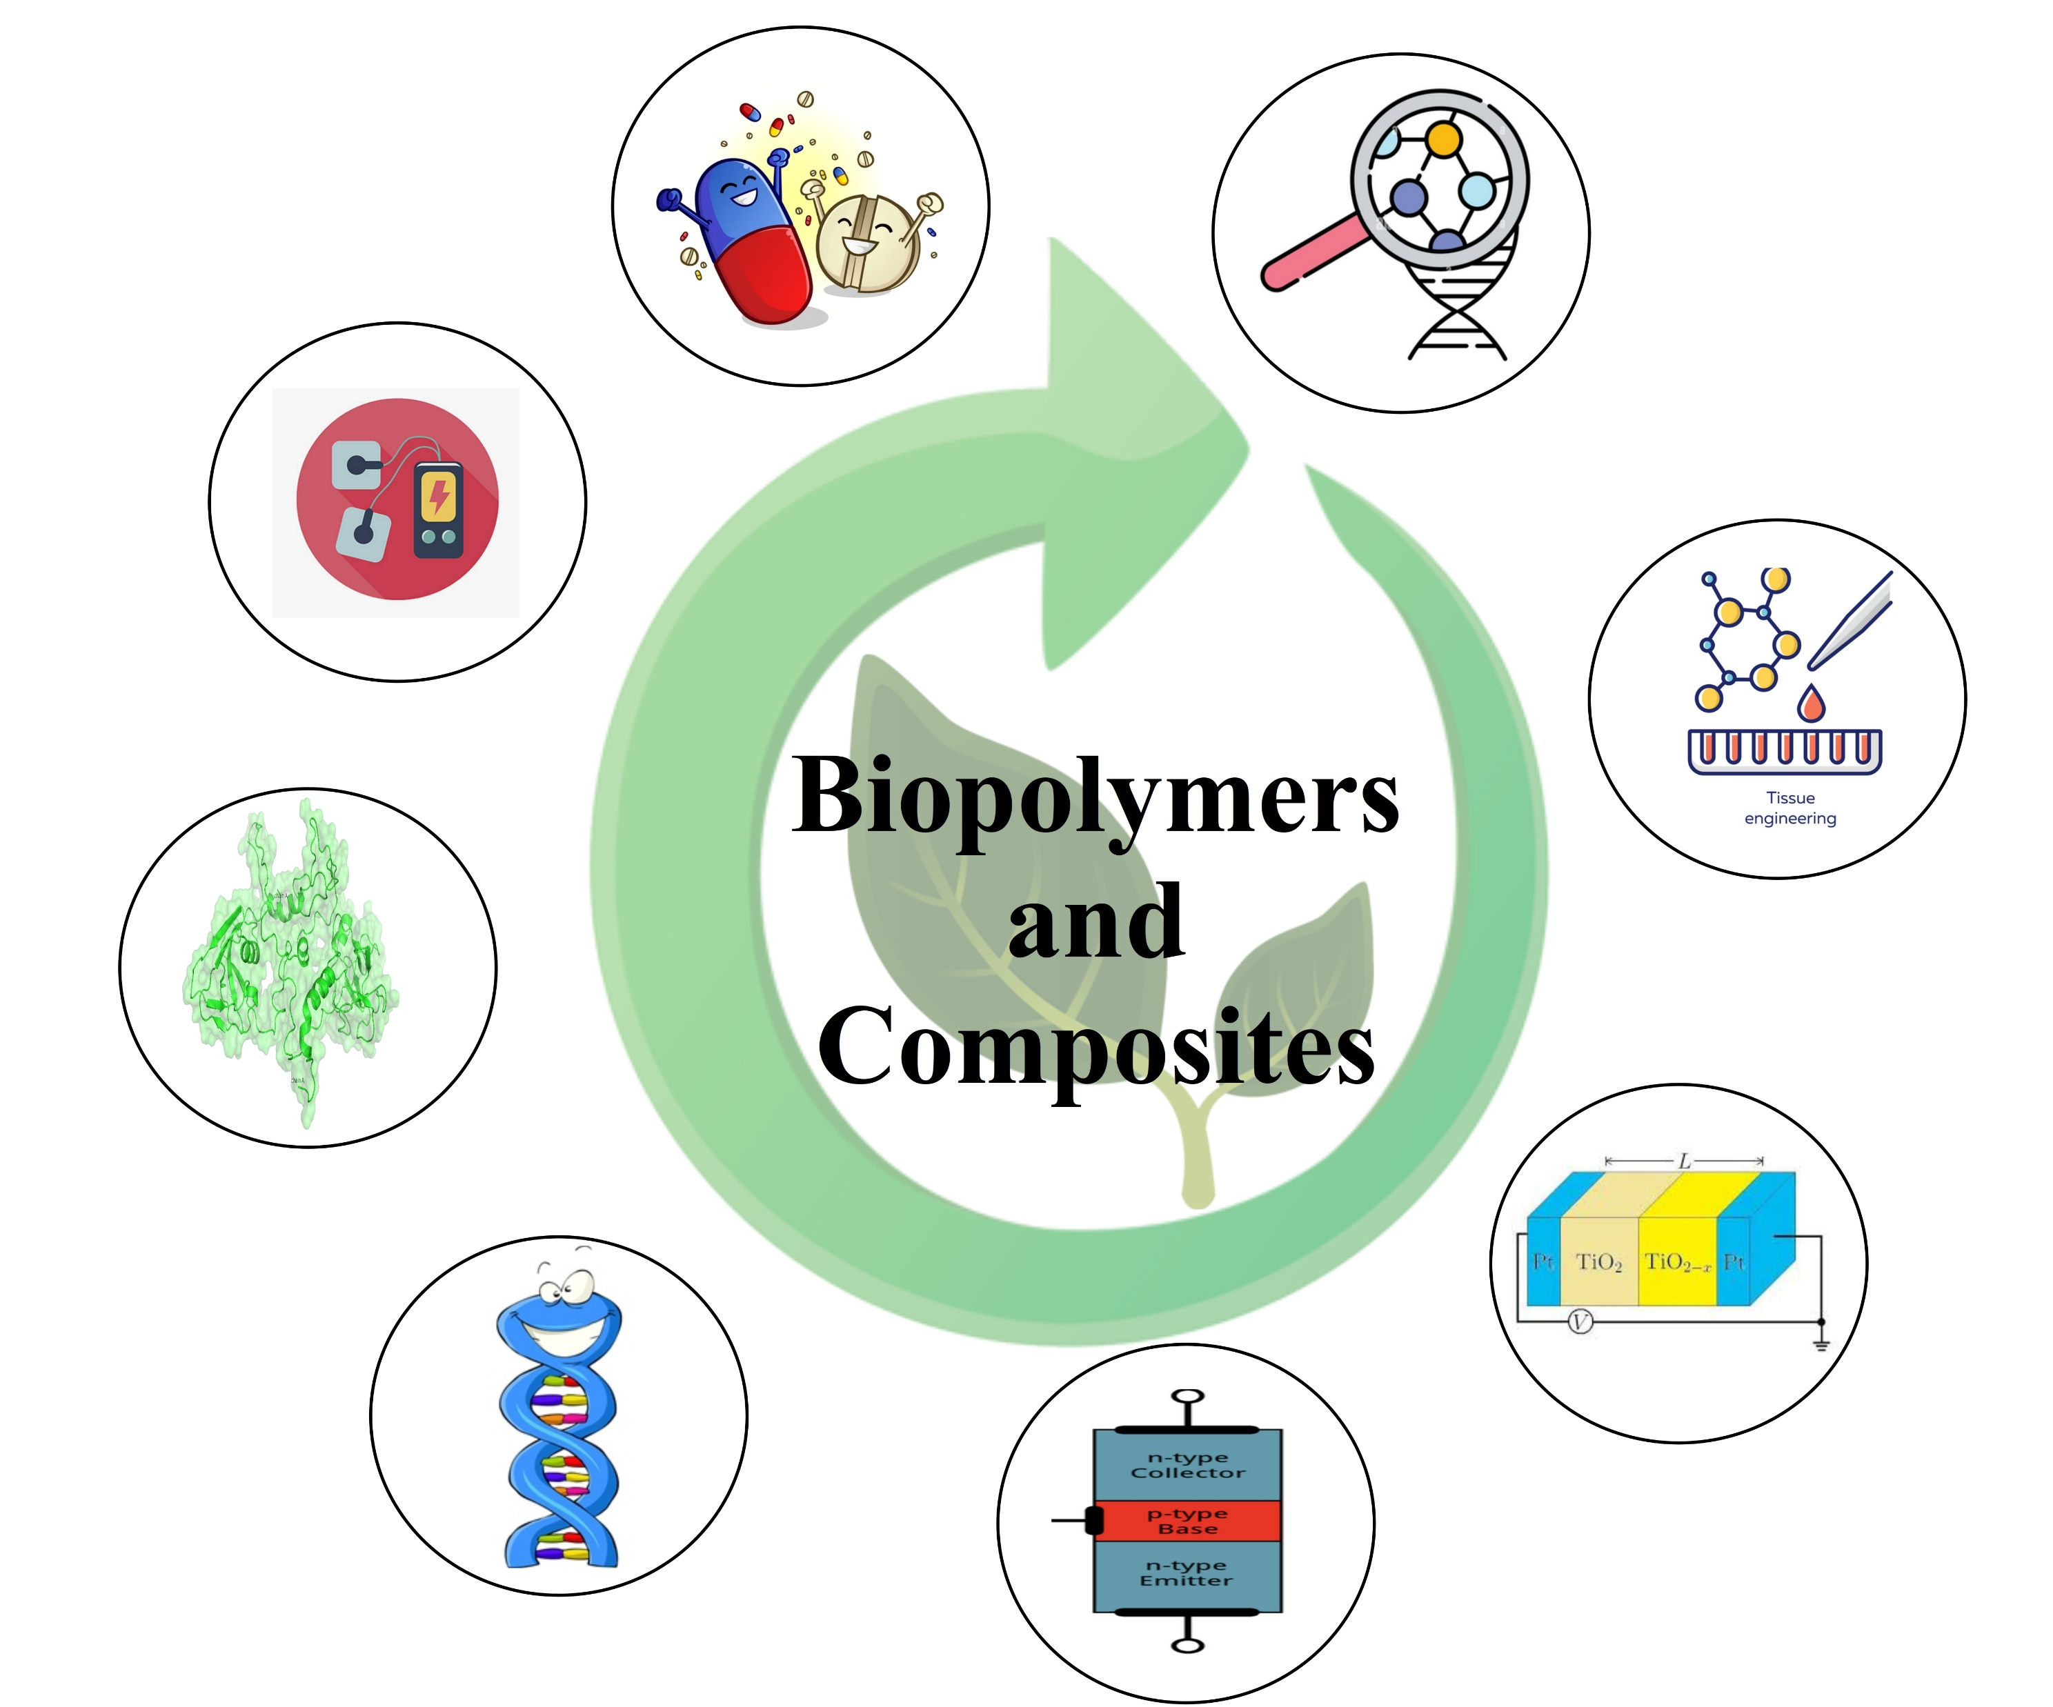

ABC-HEE, 2022
1st International Conference on Advances in Biopolymers and Composites: Health, Environment, and Energy
October 20-22, 2022
Organized by
Motilal Nehru National Institute of Technology Allahabad
Prayagraj- 211004, India
Tittle of the study
Authors name (presenter must be in bold and underlined)
Affiliation
Corresponding email :
Abstract id: ABC-HEE_XXXX
Abstract, Concept, Findings, conclusions etc should be included

